Slide 1


16 July 2020 16 July 2020
Developer testing
Stefan Agache
Nicoleta Scrimint
27 July 2020

Slide 2
Agenda
Why do we need developer testing
What developer tests are
When developer tests could be done
Notes:
Introduction - 16-16.30
Demo unit testing - 16.30-16.50
Break - 16.50-17
Demo unit testing - 17.00-17.50
Break - 17.50-18
Demo unit testing QA - 18.00-18.10
Demo integration testing - 18.10-18.50
Break - 18.50-19
Demo integration testing - 19-19.25
Code coverage - 19.25-19.45
QA - 19.45-20

Slide 3
The goal of unit testing
“The goal is to enable sustainable growth of the software project”
“Unit testing practices lead to a better design”
“Tests act as a safety net - a tool that provides insurance against a vast majority of bugs”
“The quality of the test code matters as much as the production code”
According to Vladimir Khorikov, Unit Testing Principles, Practices, and Patterns.
Notes:
“If you find that code is hard to unit test, it’s a strong sign that the code needs improvement. The poor quality usually manifests itself in tight coupling, which means different pieces of production code are not decoupled from each other enough, and it’s hard to test them separately.”
“The term sustainable is key. It’s quite easy to grow a project, especially when you start from scratch. It’s much harder to sustain this growth over time.”
“Tests help overturn the tendency of the code to deteriorate over time. They act as a safety net—a tool that provides insurance against a vast majority of regressions. Tests help make sure the existing functionality works, even after you introduce new features or refactor the code to better fit new requirements.”
“An unfortunate fact of programming life is that code is not an asset, it’s a liability. The larger the code base, the more exposure it has to potential bugs. That’s why it’s crucial to develop a good protection against regressions. Without such protection, you won’t be able to sustain the project growth in a long run—you’ll be buried under an ever-increasing number of bugs.”
“Don’t cut corners when writing tests; treat the test code as a first-class citizen.”
According to Vladimir Khorikov, Unit Testing Principles, Practices, and Patterns.

Slide 4
What is a unit test
“A unit test is an automated test that:
Verifies a small piece of code (also known as a unit)
Does it quickly
And does it in an isolated manner”
“Tests should verify units of behavior, not units of code”
Isolation between unit tests - shared/external dependencies
According to Vladimir Khorikov, Unit Testing Principles, Practices, and Patterns.
Notes:
“The isolation issue is the root of the differences between the classical and London schools of unit testing.
The London school describes it as isolating the system under test from its collaborators
In the classical approach, it’s not the code that needs to be tested in an isolated manner. Instead, unit tests themselves should be run in isolation from each other”
According to Vladimir Khorikov, Unit Testing Principles, Practices, and Patterns.

Slide 5
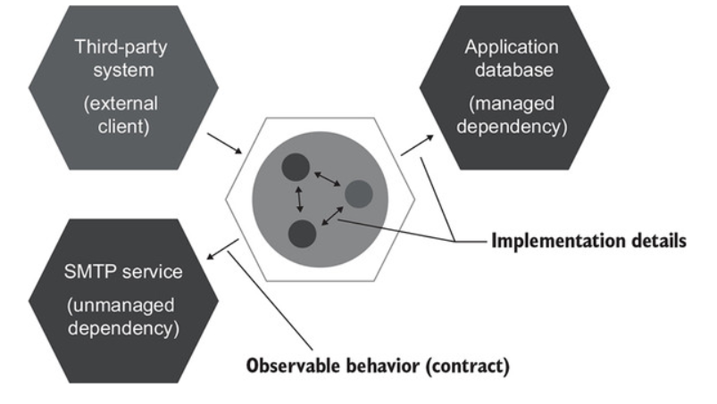
Dependencies types
According to Vladimir Khorikov, Unit Testing Principles, Practices, and Patterns.
Notes:
“Communications with managed dependencies are implementation details; use such dependencies as-is in integration tests. Communications with unmanaged dependencies are part of your system’s observable behavior. Such dependencies should be mocked out.”
“Tests must focus on the whats, not the hows”
“For a piece of code to be part of the system’s observable behavior, it has to do one of the following things:
Expose an operation that helps the client achieve one of its goals. An operation is a method that performs a calculation or incurs a side effect or both.
Expose a state that helps the client achieve one of its goals. State is the current condition of the system.
Any code that does neither of these two things is an implementation detail”
“Ideally, the system’s public API surface should coincide with its observable behavior, and all its implementation details should be hidden from the eyes of the clients. Such a system has a well-designed API”
According to Vladimir Khorikov, Unit Testing Principles, Practices, and Patterns.

Slide 6
Attributes of a good unit test
“Protection against regressions”
“Resistance to refactoring - false positives”
“Fast feedback”
“Maintainability”
According to Vladimir Khorikov, Unit Testing Principles, Practices, and Patterns.

Slide 7
Attributes for a successful test suite
“It’s integrated into the development cycle.”
“It targets only the most important parts of your code base.”
“Code coverage as a good negative indicator”
“In most applications, the most important part is the part that contains business logic—the domain model”
“It provides maximum value with minimum maintenance costs
“Recognizing a valuable test (and, by extension, a test of low value)”
“Writing a valuable test”
According to Vladimir Khorikov, Unit Testing Principles, Practices, and Patterns.
Notes:
“Coverage metrics, while providing valuable feedback, can’t be used to effectively measure the quality of a test suite. It’s the same situation as with the ability to unit test the code: coverage metrics are a good negative indicator but a bad positive one.”
“If a metric shows that there’s too little coverage in your code base—say, only 10%—that’s a good indication that you are not testing enough. But the reverse isn’t true: even 100% coverage isn’t a guarantee that you have a good-quality test suite. A test suite that provides high coverage can still be of poor quality.”
“All other parts than the domain model can be divided into three categories:
Infrastructure code
External services and dependencies, such as the database and third-party systems
Code that glues everything together”
“In order to follow the second guideline, you should isolate the domain model from the non-essential parts of the code base. You have to keep the domain model separated from all other application concerns so you can focus your unit testing efforts on that domain model exclusively.”
“To recognize a test of high value, you need a frame of reference. On the other hand, writing a valuable test requires you to also know code design techniques. Unit tests and the underlying code are highly intertwined, and it’s impossible to create valuable tests without putting significant effort into the code base they cover.”
According to Vladimir Khorikov, Unit Testing Principles, Practices, and Patterns.

Slide 8
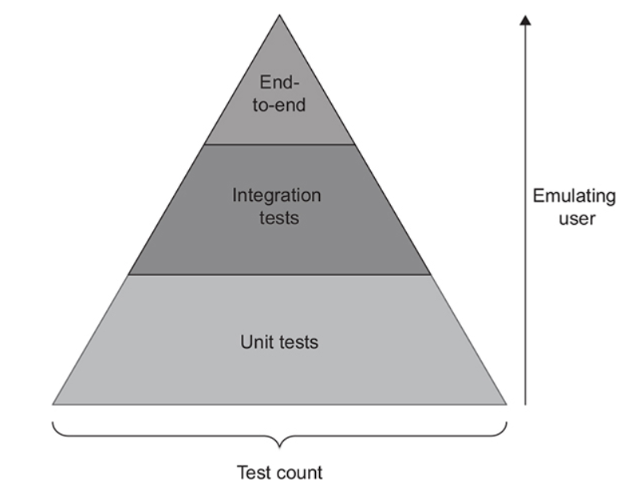
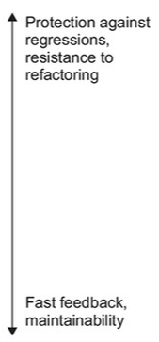
Tests piramid
According to Vladimir Khorikov, Unit Testing Principles, Practices, and Patterns.
Notes:
“Different types of tests in the pyramid make different choices in the trade-off between fast feedback and protection against regressions. Tests in higher pyramid layers favor protection against regressions, while lower layers emphasize execution speed”
“The reason end-to-end tests are the minority is, again, the multiplication rule described in section 4.4. End-to-end tests score extremely low on the metric of fast feedback. They also lack maintainability: they tend to be larger in size and require additional effort to maintain the involved out-of-process dependencies. Thus, end-to-end tests only make sense when applied to the most critical functionality—features in which you don’t ever want to see any bugs—and only when you can’t get the same degree of protection with unit or integration tests. The use of end-to-end tests for anything else shouldn’t pass your minimum required value threshold. Unit tests are usually more balanced, and hence you normally have many more of them.”
According to Vladimir Khorikov, Unit Testing Principles, Practices, and Patterns.

Slide 9
When to test
After writing production code
Test driven development

Slide 10
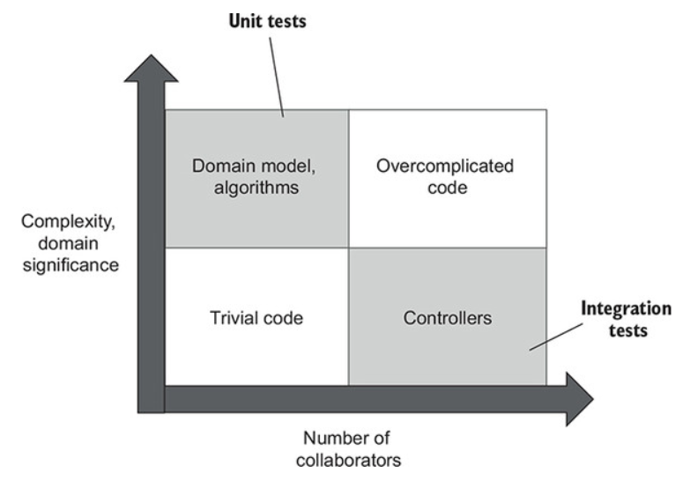
What to test
According to Vladimir Khorikov, Unit Testing Principles, Practices, and Patterns.
Notes:
“Integration tests cover controllers, while unit tests cover the domain model and algorithms. Trivial and overcomplicated code shouldn’t be tested at all.”
“Unit tests cover the domain model, while integration tests check the code that glues that domain model with out-of-process dependencies.”
“Trivial code isn’t worth the effort, while overcomplicated code should be refactored into algorithms and controllers. Thus, all your tests must focus on the domain model and the controllers quadrants exclusively.”
According to Vladimir Khorikov, Unit Testing Principles, Practices, and Patterns.

Slide 11
Integration tests
“Integration tests almost always verify how your system works in integration with out-of-process dependencies: the database, the message bus”
“Use integration tests to cover one happy path, as well as any edge cases that can’t be covered by unit tests.”
According to Vladimir Khorikov, Unit Testing Principles, Practices, and Patterns.
Notes:
“The longest happy path is the one that goes through all out-of-process dependencies.”
“There’s no need to maintain backward compatibility in communications with managed dependencies, because your application is the only one that talks to them. External clients don’t care how you organize your database; the only thing that matters is the final state of your system. Using real instances of managed dependencies in integration tests helps you verify that final state from the external client’s point of view. It also helps during database refactorings, such as renaming a column or even migrating from one database to another”
“An end-to-end test in a scenario with an API would be a test running against a deployed, fully functioning version of that API, which means no mocks for any of the out-of-process dependencies.”
According to Vladimir Khorikov, Unit Testing Principles, Practices, and Patterns.

Slide 12
Integration tests
“Use real instances of managed dependencies; replace unmanaged dependencies with mocks.”
“Integration tests host the application within the same process and substitute unmanaged dependencies with mocks”
According to Vladimir Khorikov, Unit Testing Principles, Practices, and Patterns.

Slide 13
Mocks
Stubs and mocks
“Use mocks for out of process dependencies that you do not own, in order to ensure backwards compatibility”
“Asserting interactions with stubs is a common anti-pattern that leads to fragile tests.”
According to Vladimir Khorikov, Unit Testing Principles, Practices, and Patterns.
Notes:
“Mocks help to emulate and examine outcoming interactions between the SUT and its dependencies, while stubs only help to emulate incoming interactions, not examine them”
“Mocking is legitimate only when it’s used for inter-system communications—communications that cross the application boundary—and only when the side effects of those communications are visible to the external world.”
“The requirement to always preserve the communication pattern between your application and external systems stems from the necessity to maintain backward compatibility. You have to maintain the way your application talks to external systems. That’s because you can’t change those external systems simultaneously with your application; they may follow a different deployment cycle, or you might simply not have control over them”
“A call from the SUT to a stub is not part of the end result the SUT produces. Such a call is only a means to produce the end result: a stub provides input from which the SUT then generates the output.”
According to Vladimir Khorikov, Unit Testing Principles, Practices, and Patterns.

Slide 14
Demo unit tests

Slide 15
Questions unit testing

Slide 16
Demo integration tests

Slide 17
Demo code coverage

Slide 18
QA

Slide 19
Bibliography
Vladimir Khorikov - Unit testing - https://www.manning.com/books/unit-testing
Roy Osherove - The Art of Unit Testing - https://www.manning.com/books/the-art-of-unit-testing-second-edition
TDD - https://cleancoders.com/series/clean-code/advanced-tdd

